Slide 1
Cowin Vaccine Slot Tracker (industrial oriented mini-project)
By,
M.Prathyusha Lahari,
18261A0539,
IV/IV CSE-1.

Slide 2
PROBLEM STATEMENT : Challenges Faced
As in India, only 18+ had their vaccine dose and only 21.9% have completed their second-dose vaccine. Children still left for vaccine.
Source :Globally, India Has the Highest Gap Between Number of First, Second Doses of COVID Vaccines
Mainly in Tier-2 Cities, semi-urban and rural areas, Still the availability of vaccine and slots is not accurate.
COWIN Slots generally get available for a few seconds (for 18+ age-group) i.e. the slots get booked very fast.

Slide 3
Problem Definition
The objective of this project is to create Telegram-bot solution for finding vaccination slots for the COVID-19 Vaccination.
Use the companion bot for finding slot quickly with the help of COWIN API in Python.
Checks and alert for available slots for covid vaccines for available pin codes and districts.

Slide 4
Design Methodology
Initially, Creating a telegram bot. Updating JSON File with TOKEN and ChatID of Created Telegram Bot.
Starting a Docker/Cloud Server to Send Requests to COWIN API Via Telegram Server.
Running Python Script to start API request Session.
Pinging the public COWIN API by Telegram Server ,to get district-wise/pin-code wise data and checking for availability, every 2-5 minutes.
If there is a slot available in the district id or pin code provided, you will receive an alert .as,Relaying this information to the user's mobile via Telegram Bot.

Slide 5
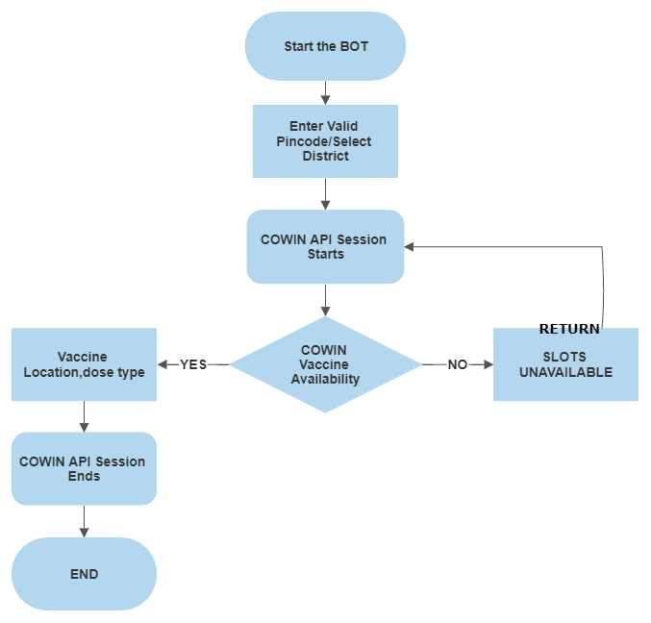
FLOW CHART

Slide 6
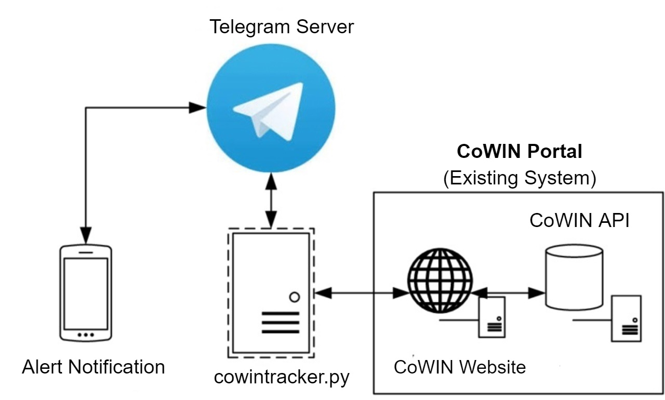
SYSTEM Architecture

Slide 7
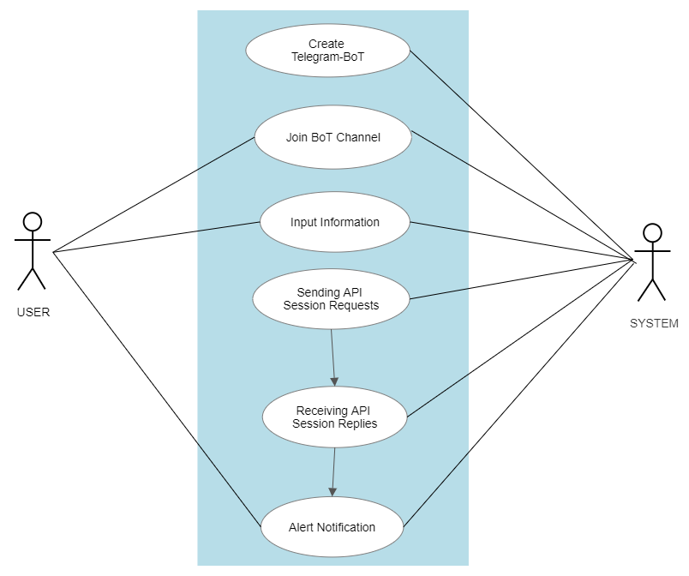
UML Diagram

Slide 8
Literature Survey
S.No | Paper Title, Year of Publication | Algorithms/Methods Used | Link to the paper
1. | Automated Motion Detection Security System Notifier using Raspberry Pi with Telegram,2020. | Raspberry Pi senses and sends alerts using telegram. | https://ieeexplore.ieee.org/document/9188111
2. | Realtime monitoring of Bitcoin prices on several Cryptocurrency markets using Web API, Telegram Bot, MySQL Database, and PHP-Cronjob,2020 | Shared-Web API from stock-exchange websites like Coin Gecko using telegram bot. | https://ieeexplore.ieee.org/document/9321109
3. | Reporting Sleepy Driver into Channel Telegram via Telegram Bot,2019 | Linear SVM and Web API using telegram bot. | https://ieeexplore.ieee.org/document/8986000
4. | Botanicum: a Telegram Bot for Tree Classification,2018. | Classification and Feature engineering | https://www.researchgate.net/publication/327782514_Botanicum_a_Telegram_Bot_for_Tree_Classification
5. | Chatting with Arduino platform through Telegram Bot,2016 | Arduino | https://ieeexplore.ieee.org/document/7797406

Slide 9
References
Using a Telegram chatbot as cost-effective software infrastructure for ambulatory assessment studies with iOS and Android devices
Telegram Alert Notification as a new model of internet-based transactions
Alert notification as a service
Telegram Bot API

